Slide 1
MGB235 Monitoring and Managing Operational Performance
Week 2 – Quality Management
Dr Kavoos Mohannak
Chapter 9:
Stevenson, W.J. (2021) 14th ed. Operations Management, McGraw Hill, New York, NY.
Chapter 2:
Russell, Roberta S., and Taylor III, Bernard W. (2017) Operations and Supply Chain management,
9th ed., Hoboken, NJ.

Slide 2
Lecture outline
What Is Quality?
Dimensions of Quality
Quality Management Systems
A Tool to Identify Quality Problems - The Gap Model
Principles of Total Quality Management
Designing Quality Management and Control Systems
Cost of Quality
Benefits of Quality to the Firm

Slide 3
Three issues that are critical to operations managers (all managers, for that matter)
Productivity: Ratio of outputs to inputs, do more with less;
Cost: Reduce the cost of production, lower price; increase competitiveness; increase market share;
Quality: Produce a superior/better /higher quality service - product;
The desired outcome:
Satisfied Customers who get more for less
Increase Customer Value

Slide 4
What Is Quality? What do you think makes a quality product?
Oxford American Dictionary
a degree or level of excellence
American Society for Quality
totality of features and characteristics that satisfy needs without deficiencies

Slide 5
Quality Management
Quality
The ability of a product or service to consistently meet or exceed customer expectations
For a decade or so, quality was an important focal point in business. After a while, this emphasis began to fade as other concerns took precedence
There has been a recent resurgence in attention to quality given recent experiences with the costs and adverse attention associated with highly visible quality failures:
Auto recalls
Toys
Produce
Dog food
Pharmaceuticals
Copyright ©2021 McGraw-Hill Education. All rights reserved. No reproduction or distribution without the prior written consent of McGraw-Hill Education.

Slide 6
Dimensions of Product Quality
Performance – main characteristics of the product
Aesthetics – appearance, feel, smell, taste
Special features – extra characteristics
Conformance – how well the product conforms to design specifications
Reliability – consistency of performance
Durability – the useful life of the product
Perceived quality – indirect evaluation of quality
Serviceability – handling of complaints or repairs
Consistency – quality doesn’t vary
Copyright ©2021 McGraw-Hill Education. All rights reserved. No reproduction or distribution without the prior written consent of McGraw-Hill Education.

Slide 7
Dimensions of Service Quality
Convenience – the availability and accessibility of the service
Reliability – ability to perform a service dependably, consistently, and accurately
Responsiveness – willingness to help customers in unusual situations and to deal with problems
Time – the speed with which the service is delivered
Assurance – knowledge exhibited by personnel and their ability to convey trust and confidence
Courtesy – the way customers are treated by employees
Tangibles – the physical appearance of facilities, equipment, personnel, and communication materials
Consistency – the ability to provide the same level of good quality repeatedly
Expectancy – meet (or exceed) customer expectations
Copyright ©2021 McGraw-Hill Education. All rights reserved. No reproduction or distribution without the prior written consent of McGraw-Hill Education.

Slide 8
Assessing Service Quality (Gap Model)
Audit service to identify strengths and weaknesses
In particular, look for discrepancies between:
Customer expectations and management perceptions of those expectations
Management perceptions, customer expectations, and service-quality specifications
Service quality and service actually delivered
Service actually delivered and what is communicated about the service to customers
Customers’ expectations of the service provider and their perceptions of provider delivery
Copyright ©2021 McGraw-Hill Education. All rights reserved. No reproduction or distribution without the prior written consent of McGraw-Hill Education.

Slide 9
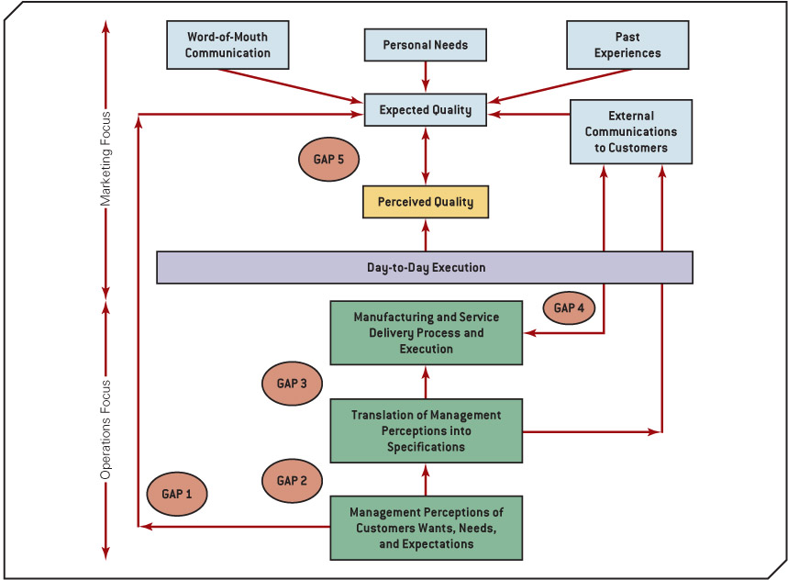
A Tool to Identify Quality Problems - The Gap Model
How does one ensure quality at all levels of the organisation?
The GAP model recognizes that there are several ways to misspecify and mismanage the creation and delivery of high levels of quality. These "gaps“ are shown in the model (Figure from Collier & Evans, 2007).

Slide 10
Summary: What is Quality Consumer’s and Producer’s perspective

Slide 11
Responsibility for Quality
Top management
Design
Procurement
Production/operations
Quality assurance
Packaging and shipping
Marketing and sales
Customer service
Everyone in the organization has some responsibility for quality, but certain areas of the organization are involved in activities that make them key areas of responsibility

Slide 12
Quality Management Systems
Quality management refers to systematic policies, methods, and procedures used to ensure that goods and services are produced with appropriate levels of quality to meet the needs of customers.
Organizations today attempt to integrate quality principles into their management systems, using tools such as Total Quality Management (TQM), Six Sigma, and Lean Operating Systems.
The challenge for many managers is adapting these tools (or formulating new tools) to service industries or the service side of a business using technology as a mediating variable
It is crucial that the supply chain is also part of the quality process

Slide 13
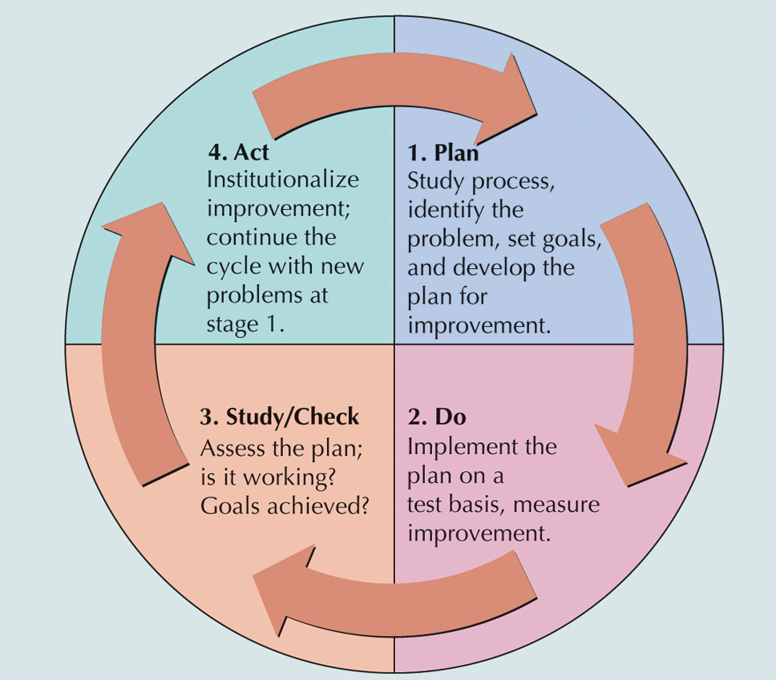
Quality Management Systems Deming Wheel: PDSA Cycle

Slide 14
PDSA Cycle
Plan
Do
Study
Act
Plan-Do-Study-Act (PDSA) cycle
Plan
Begin by studying and documenting the current process.
Collect data on the process or problem
Analyze the data and develop a plan for improvement
Specify measures for evaluating the plan
Do
Implement the plan, document any changes made, collect data for analysis

Slide 15
PDSA Cycle (cont.)
Plan
Do
Study
Act
Plan-Do-Study-Act (PDSA) cycle
Study
Evaluate the data collection during the do phase
Check results against goals formulated during the plan phase
Act
If the results are successful, standardize the new method and communicate it to the relevant personnel
Implement training for the new method
If unsuccessful, revise the plan and repeat the process

Slide 16
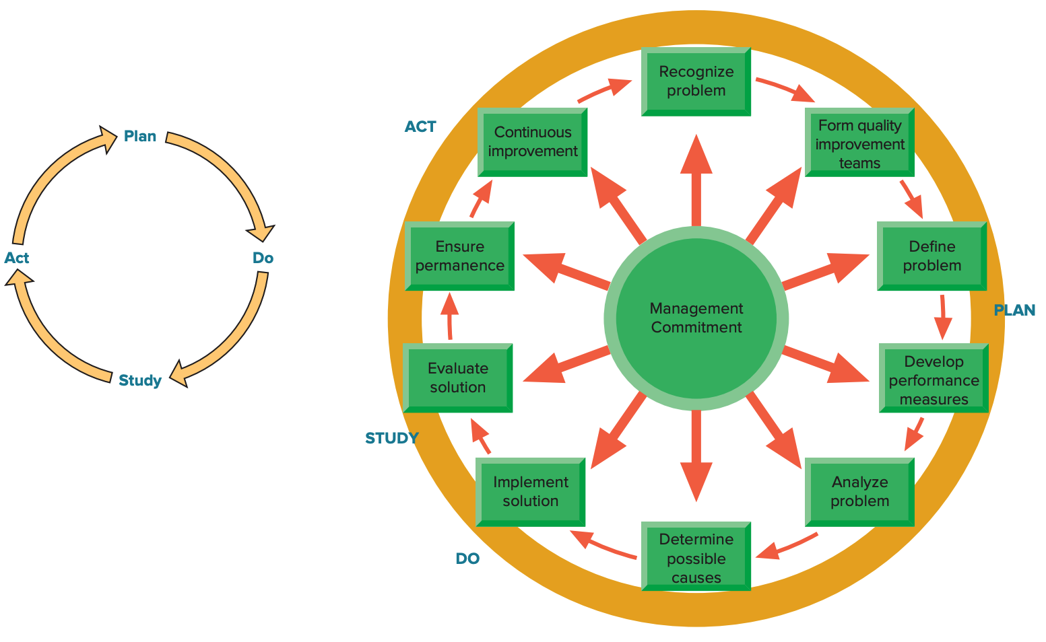
Problem Solving
Copyright ©2021 McGraw-Hill Education. All rights reserved. No reproduction or distribution without the prior written consent of McGraw-Hill Education.

Slide 17
Process Improvement
Process improvement
A systematic approach to improving a process
Map the process
Collect information about the process and identify each step in the process
Prepare a flowchart that accurately depicts the process
Analyze the process
Ask critical questions about the process
Ask specific questions about each step in the process
Redesign the process

Slide 18
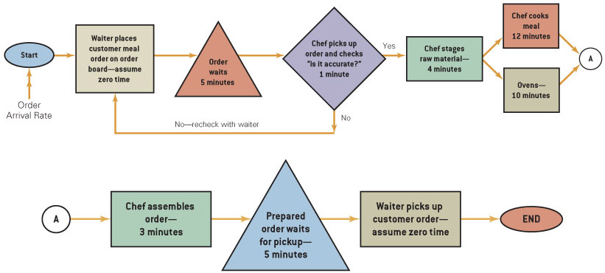
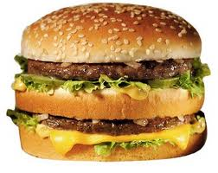
Detailed Process Design
(Collier & Evans, 2007)

Slide 19
Quality Management Systems
Six Sigma
Six Sigma is a business improvement approach that seeks to find and eliminate causes of defects and errors in manufacturing and service processes by focusing on outputs that are critical to customers and results in a clear financial return for the organization.

Slide 20
Six Sigma
Six Sigma
A business process for improving quality, reducing costs, and increasing customer satisfaction
Statistically
Having no more than 3.4 defects per million
Conceptually
Program designed to reduce defects
Requires the use of certain tools and techniques
Copyright ©2021 McGraw-Hill Education. All rights reserved. No reproduction or distribution without the prior written consent of McGraw-Hill Education.

Slide 21
Six Sigma (cont.)
Principles
Reduction in variation is an important goal
The methodology is data driven; it requires data validation
Outputs are determined by inputs
Only a critical few inputs have a significant impact on outputs
DMAIC Process
Define: Set the context and objectives for improvement
Measure: Determine the baseline performance and capability of the process
Analyze: Use data and tools to understand the cause-and-effect relationships of the process
Improve: Develop the modifications that lead to a validated improvement of the process
Control: Establish plans and procedures to ensure that improvements are sustained

Slide 22
Total Quality Management
A philosophy that involves everyone in an organization in a continual effort to improve quality and achieve customer satisfaction
T
Q
M
Copyright ©2021 McGraw-Hill Education. All rights reserved. No reproduction or distribution without the prior written consent of McGraw-Hill Education.

Slide 23
TQM Approach
Find out what the customer wants
Design a product or service that meets or exceeds customer wants
Design processes that facilitate doing the job right the first time
Keep track of results
Extend these concepts throughout the supply chain
Top management must be involved and committed
Copyright ©2021 McGraw-Hill Education. All rights reserved. No reproduction or distribution without the prior written consent of McGraw-Hill Education.

Slide 24
TQM Elements
Continuous improvement
Competitive benchmarking
Employee empowerment
Team approach
Decision based on fact, not opinion
Knowledge of tools
Supplier quality
Champion
Quality at the source
Suppliers are partners in the process
Copyright ©2021 McGraw-Hill Education. All rights reserved. No reproduction or distribution without the prior written consent of McGraw-Hill Education.

Slide 25
Continuous Improvement
Continuous improvement
Philosophy that seeks to make never-ending improvements to the process of converting inputs into outputs
Kaizen
Japanese word for continuous improvement
Copyright ©2021 McGraw-Hill Education. All rights reserved. No reproduction or distribution without the prior written consent of McGraw-Hill Education.

Slide 26
Quality at the Source
The philosophy of making each worker responsible for the quality of his or her work
“Do it right” and “If it isn’t right, fix it”
Copyright ©2021 McGraw-Hill Education. All rights reserved. No reproduction or distribution without the prior written consent of McGraw-Hill Education.

Slide 27
Obstacles to Implementing TQM
Obstacles include:
Lack of company-wide definition of quality
Lack of strategic plan for change
Lack of customer focus
Poor intra-organizational communication
Lack of employee empowerment
View of quality as a “quick fix”
Emphasis on short-term financial results
Inordinate presence of internal politics and “turf” issues
Lack of strong motivation
Lack of time to devote to quality initiatives
Lack of leadership
Copyright ©2021 McGraw-Hill Education. All rights reserved. No reproduction or distribution without the prior written consent of McGraw-Hill Education.

Slide 28
Chapter 15 Quality Management
Designing Quality Management and Control Systems
Repeatability, or equipment variation, is the variation in multiple measurements by an individual using the same instrument. This is a measure of how precise and accurate the operational processes, people & equipment are.
Reproducibility, or operator variation, is the variation in the same measuring instrument when it is used by different individuals to measure the same parts. This indicates how robust the measuring process is to the operator and environmental conditions.

Slide 29
Quality Tools
Designing Quality Management and Control Systems
Process Flow Chart
Cause-and-Effect Diagram
Check Sheet
Pareto Analysis
Histogram
Scatter Diagram
Statistical Process
Control Chart

Slide 30
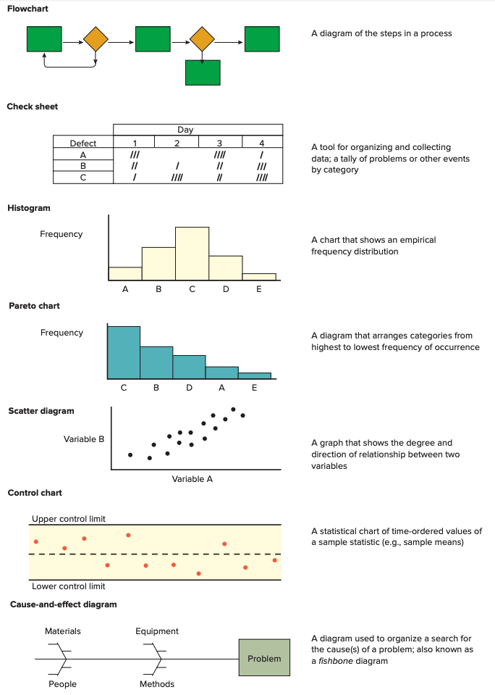
Quality Tools (cont.)
Copyright ©2021 McGraw-Hill Education. All rights reserved. No reproduction or distribution without the prior written consent of McGraw-Hill Education.

Slide 31
Quality Circles
Quality circle
Groups of workers who meet to discuss ways of improving products or processes
Less structured and more informal than teams involved in continuous improvement
Quality circle teams have historically had relatively little authority to make any but the most minor changes
Copyright ©2021 McGraw-Hill Education. All rights reserved. No reproduction or distribution without the prior written consent of McGraw-Hill Education.

Slide 32
Quality and the Supply Chain
Business leaders are increasingly recognizing the importance of their supply chains in achieving their quality goals
Requires:
Measuring customer perceptions of quality
Identifying problem areas
Correcting these problems
Supply chain quality management can benefit from a collaborative relationship with suppliers
Helping suppliers with quality assurance efforts
Information sharing on quality-related matters
Copyright ©2021 McGraw-Hill Education. All rights reserved. No reproduction or distribution without the prior written consent of McGraw-Hill Education.

Slide 33
Benchmarking Process
Identify a critical process that needs improvement
Identify an organization that excels in this process
Contact that organization
Analyze the data
Improve the critical process
Copyright ©2021 McGraw-Hill Education. All rights reserved. No reproduction or distribution without the prior written consent of McGraw-Hill Education.

Slide 34
Cost of Quality
Cost of quality: costs associated with avoiding poor quality or those incurred as a result of poor quality.
Prevention costs: expended to keep nonconforming goods and services from being made and reaching the customer (costs arising from designing quality into the product or service, staff training, prototyping).
Appraisal costs: expended on ascertaining quality levels through measurement and analysis of data to detect and correct problems (failure detected in the inputs to production, people or parts).
Internal-failure costs: costs incurred as a result of unsatisfactory quality that is found before delivery of good or service to the customer (failure arising from production process).
External-failure costs: incurred after poor-quality goods or services reach the customer (warranty).

Slide 35
Chapter 15 Quality Management
Benefits of Quality to the Firm
Investment in Quality Yields Business Results
Increased employee participation
Improved product and service quality
Improved customer satisfaction
Improved productivity
Improved employee skills
Improved financial performance
Improved organisational reputation

Slide 36
The Consequences of Poor Quality
Loss of business
Liability
Productivity
Costs
Copyright ©2021 McGraw-Hill Education. All rights reserved. No reproduction or distribution without the prior written consent of McGraw-Hill Education.

Slide 37
Ethics and Quality
Substandard work
Defective products
Substandard service
Poor designs
Shoddy workmanship
Substandard parts and materials
Having knowledge of this and failing to correct
and report it in a timely manner is unethical.
Copyright ©2021 McGraw-Hill Education. All rights reserved. No reproduction or distribution without the prior written consent of McGraw-Hill Education.

Slide 38
Additional References:
Kennedy, Mark T and Peer C Fiss (2009), Institutionalization, framing, and diffusion: The logic of TQM adoption and implementation decisions among US Hospitals, Academy of Management Journal, 52/5, pp. 897-918 (Copy on QUT Readings)
Zhao, Xiande, Andy C.L. Yeung, T.S Lee (2004), Quality management and organisational context in selected service industries in China, Journal of Operations Management, 22, pp. 575-587 (Copy on QUT Readings)
Websites:
International Standards Organisation
Six Sigma

Slide 39
Next Week
Organisational Strategy and Operations & Measuring Performance

